Slide 1

A Crime Analysis And Prediction Using machine learning & Deep Learning
PRESENTED BY :-
P.DHANJAY SAH 23495A0511
SK.MUHAMMAD MAAZ 23495A0516
V.PRADEEP RAJ 23495A0521
Y.DIVYA LEKHANA 23495A0522
K.SRINIVAS 23495A0543
C.JOHN JASHUVA 21495A0509
Under the Guidance of
Dr D Sharadha Mani
Associate professor
Department of AIML

Slide 2
OUTLINES
ABSTRACT
INTRODUCTION
OBJECTIVE
EXISTING METHOD
PROPOSED METHOD
EXPLANATION OF PROPOSED WORK
HARDWARE & SOFTWARE COMPONENTS
WORKING OF WEB PAGE
ADVANTAGES AND APPLICATION
FUTURE SCOPE
REFERENCES

Slide 3
ABSTRACT
This project applies Machine Learning (ML) and Deep Learning (DL) methods to mine historical crime records, detect patterns, and make predictions about future crime events. Through the processing of geospatial, temporal, and socio-economic variables, the system generates useful information for policymakers and law enforcement. ML algorithms such as XG-Boost and Random Forest are employed for crime prediction and trend analysis, while LSTM networks extract temporal relationships to predict crime rates. A web application based on Flask enables users to enter city and crime information for real-time analysis and forecasting, facilitated by visualization tools for informed decision-making. This AI-based methodology improves crime prevention, strategic planning, and public safety through data-driven intelligence.

Slide 4
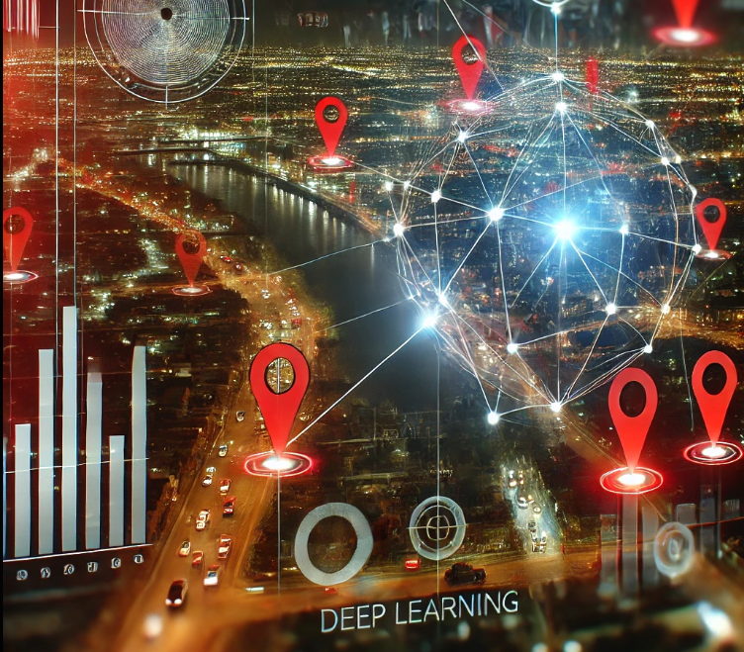
INTRODUCTION
Crime analysis facilitates the understanding of crime patterns through data-driven methods. Trends are detected by Machine Learning (ML) models, and future crimes are predicted by Deep Learning (DL) models based on past data. Our project incorporates these technologies into an interactive web application that supports law enforcement and policymakers in making data-driven decisions for crime prevention and public safety.

Slide 5
OBJECTIVE
Forecast crime trends: Employ deep learning to predict where and when crime is more probable to take place.
Identify hotspots: Identify areas of high crime rates in order to target resources appropriately.
Improve law enforcement: Facilitate decision-making for crime prevention measures.
Shorten response time: Allow faster response by predication of crime.
Enhance public safety: Ultimately lower crime rates with insights driven by data.

Slide 6
Existing Methods
Regression Analysis: Uses past data to predict future crime occurrences based on socio-economic factors.
Decision Trees/Random Forests: Classifies and predicts crimes by learning patterns from data.
Support Vector Machines (SVM): Separates crime data into categories for prediction.
K-Nearest Neighbors (KNN): Predicts crime by comparing new incidents with similar past events.
Hotspot Analysis: Identifies high-crime areas using geospatial data.
Time Series Analysis: Predicts crime trends over time.
Neural Networks: Uses layers of nodes to learn complex crime patterns and make predictions.

Slide 7
Proposing Methods
📌 Data Preprocessing: Cleaning and preprocessing raw crime data with label encoding and feature scaling.
📌 Machine Learning Models
Training models such as XG-Boost and Random Forest for crime analysis.
📌 Deep Learning for Prediction
Applying LSTM-based neural networks to forecast upcoming crime patterns.
📌 Flask-Based Web Application
Creating an easy-to-use interface for crime prediction and analysis.
📌 Model Deployment & Real-Time Insights
Hosting deployed models and building dynamic crime insights.

Slide 8
Explanation of The Proposed Work

Slide 9
Data Collection & Storage
Future Crime Prediction(DL)
Backend
(FLASK&DB)
Deployment And Monitoring
Data Pre-Processing
Crime Pattern Analysis(ML)
User Interaction
Web App

Slide 10
Data Collection & Storage :Gathers raw crime data from CSV files from Kaggle.com
Data Pre-Processing: Cleans, encodes, and scales data to prepare it for model training.
Crime Pattern Analysis (ML) :By using machine learning to identify trends and correlations in crime data.
Future Crime Prediction (DL) : Employs deep learning models (LSTM) to forecast future crime occurrences.
Backend (Flask & DB): Manages API requests, database storage, and connects the frontend to ML models.
Web App: Displays crime analysis results, predictions, and interactive reports for users.
Deployment & Monitoring : Deploys the web app online and tracks model performance for updates.
User Interaction:Allows users to input queries, view results, and interact with the system.

Slide 11
HARDWARE AND SOFTWARE COMPONENTS

Slide 12
Hardware Components
High-Performance Computing Hardware:
GPU (Graphics Processing Unit): Essential for training deep learning models efficiently. NVIDIA GPUs like the Tesla, RTX, or Quadro series are recommended.
CPU: A powerful multi-core processor for handling data preprocessing and general computations. Intel Core i7/i9 or AMD Ryzen 7/9 processors are good choices.
Memory:
RAM: At least 16GB, though 32GB or more is recommended for handling large datasets.
Storage:
SSD (Solid State Drive): A fast storage option is necessary for quick data access and model training. 1TB SSD is a good starting point.

Slide 13
Software Components
Programming Language:
Python: Widely used in deep learning due to its extensive libraries.
Deep Learning Frameworks:
Py-Torch: Popular frameworks for building and training deep learning models.
Keras: High-level API that runs on top of TensorFlow for quick prototyping.
Data Processing Libraries:
Pandas: For handling and preprocessing datasets.
NumPy: For numerical computations.
scikit-learn: For data preprocessing, model evaluation, and feature engineering.
Database:
MongoDB: If you prefer a NoSQL database.
Data Visualization Tools:
Matplotlib : For visualizing data and model results.

Slide 14
WORKING OF CRIME ANALYSIS AND PREDICTION

Slide 15
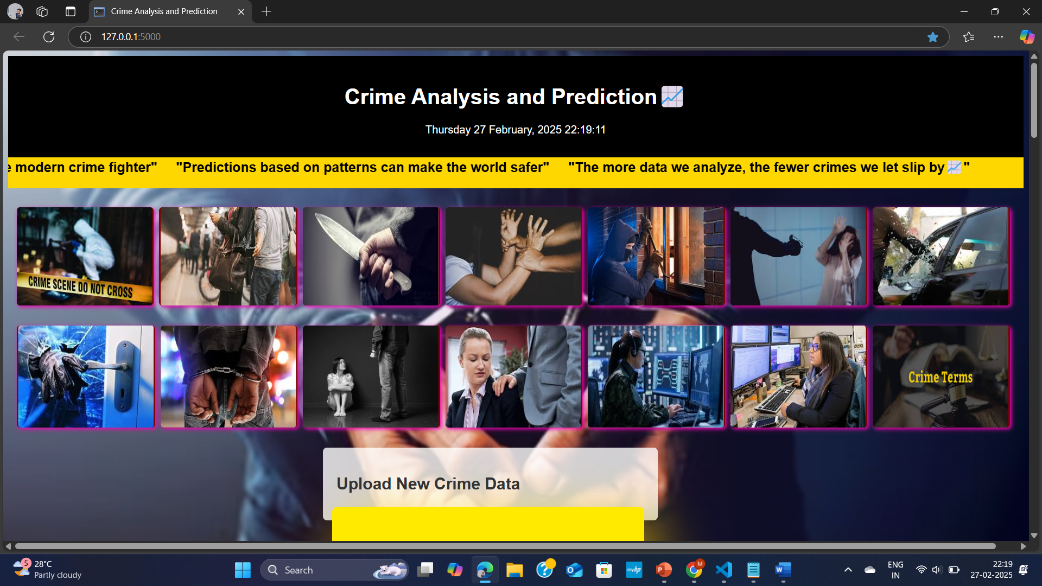

Slide 16
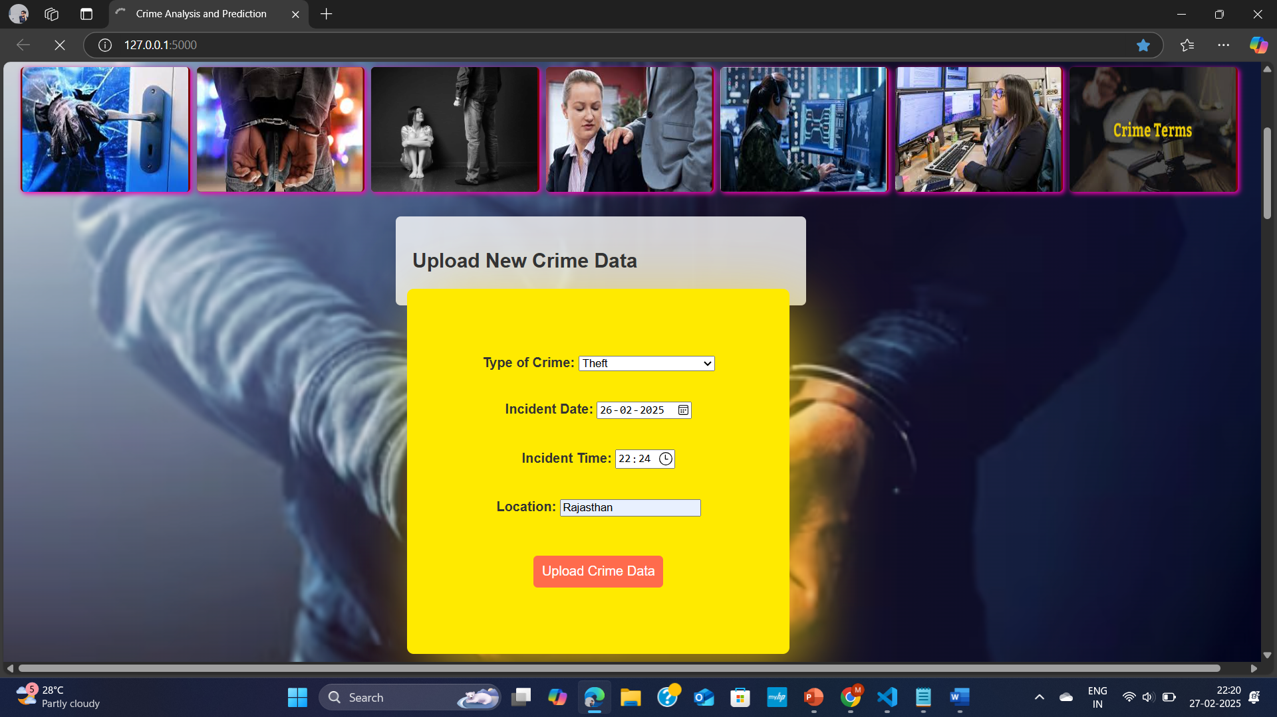

Slide 17


Slide 18
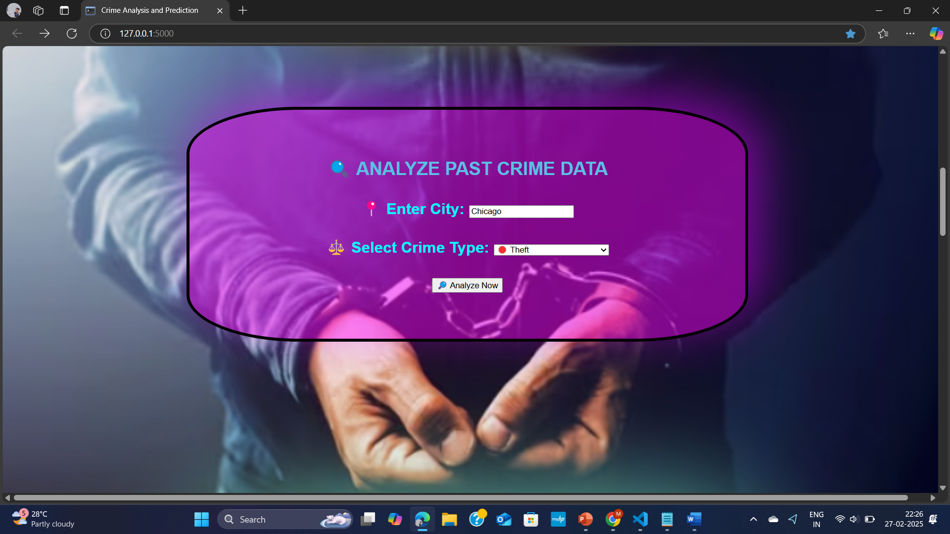

Slide 19
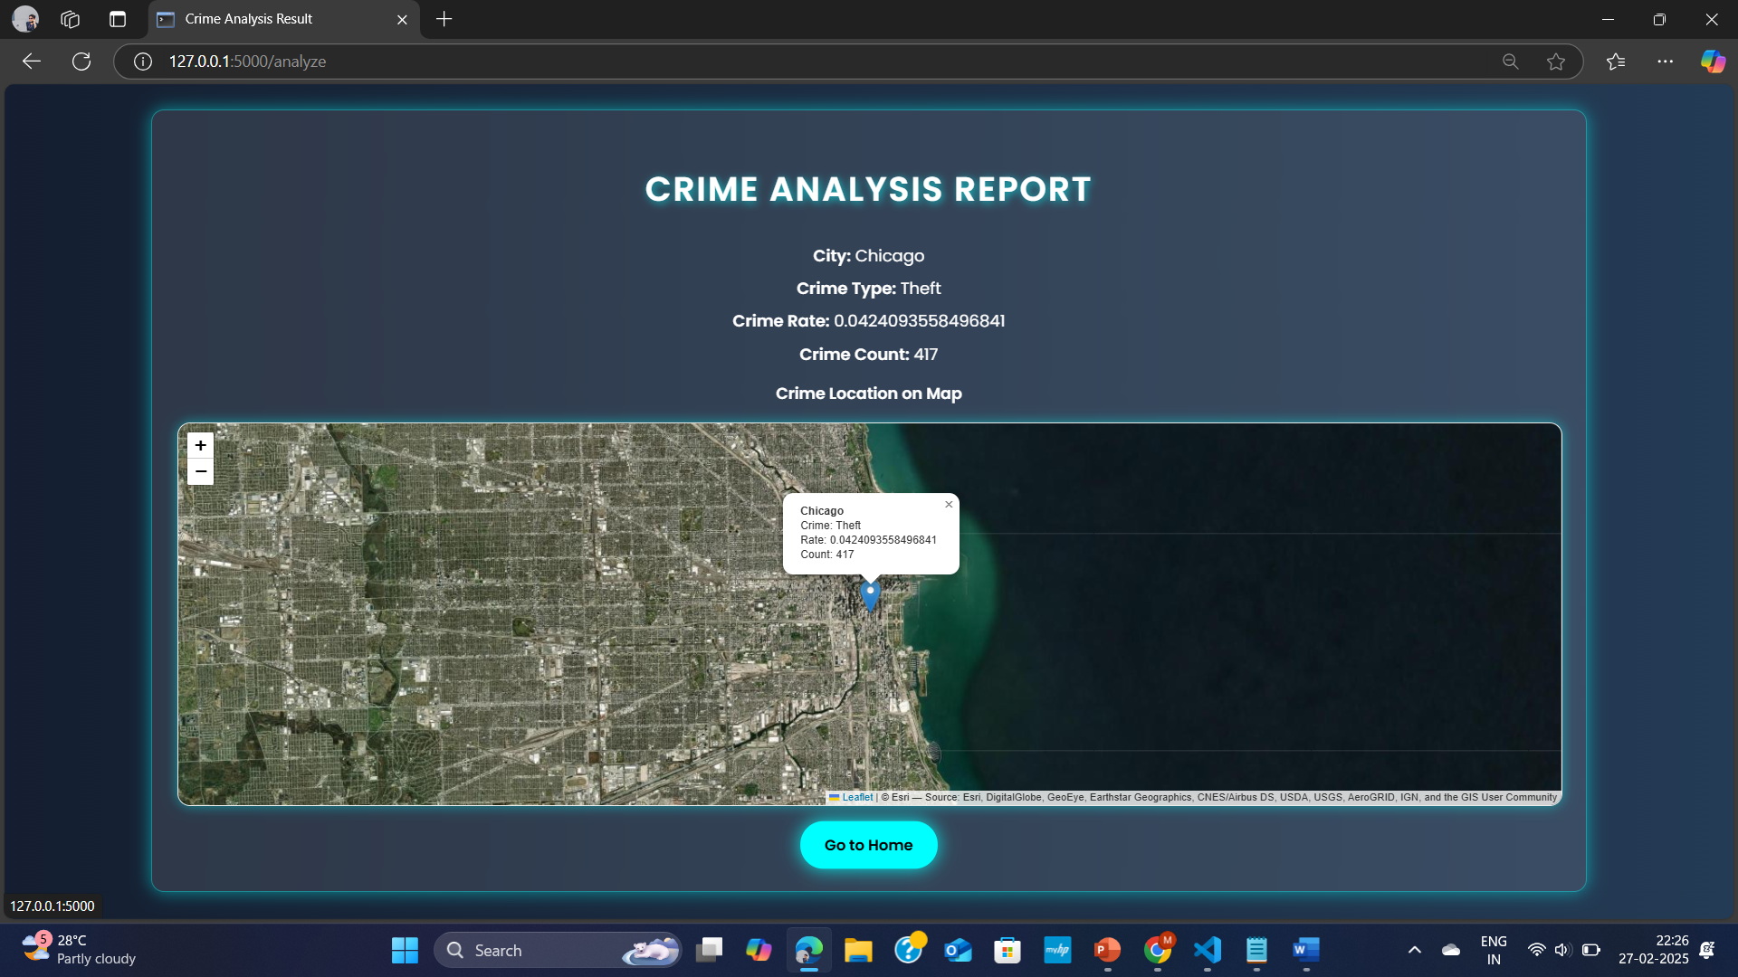

Slide 20
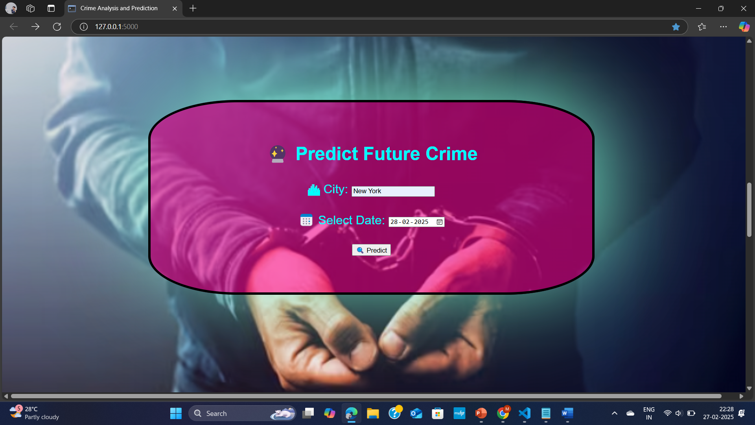

Slide 21
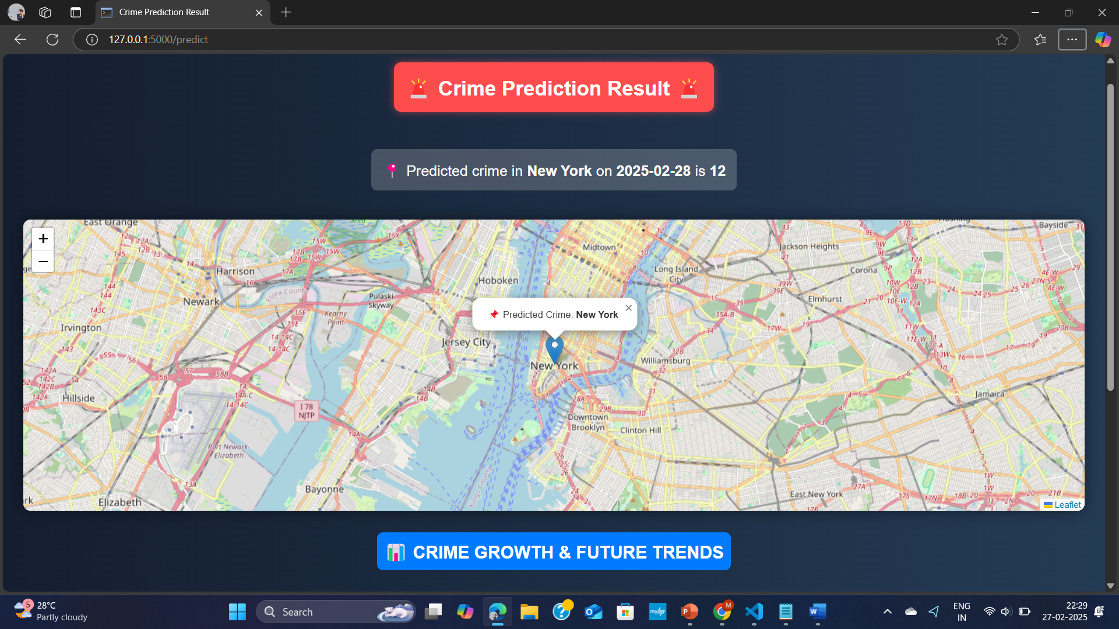

Slide 22
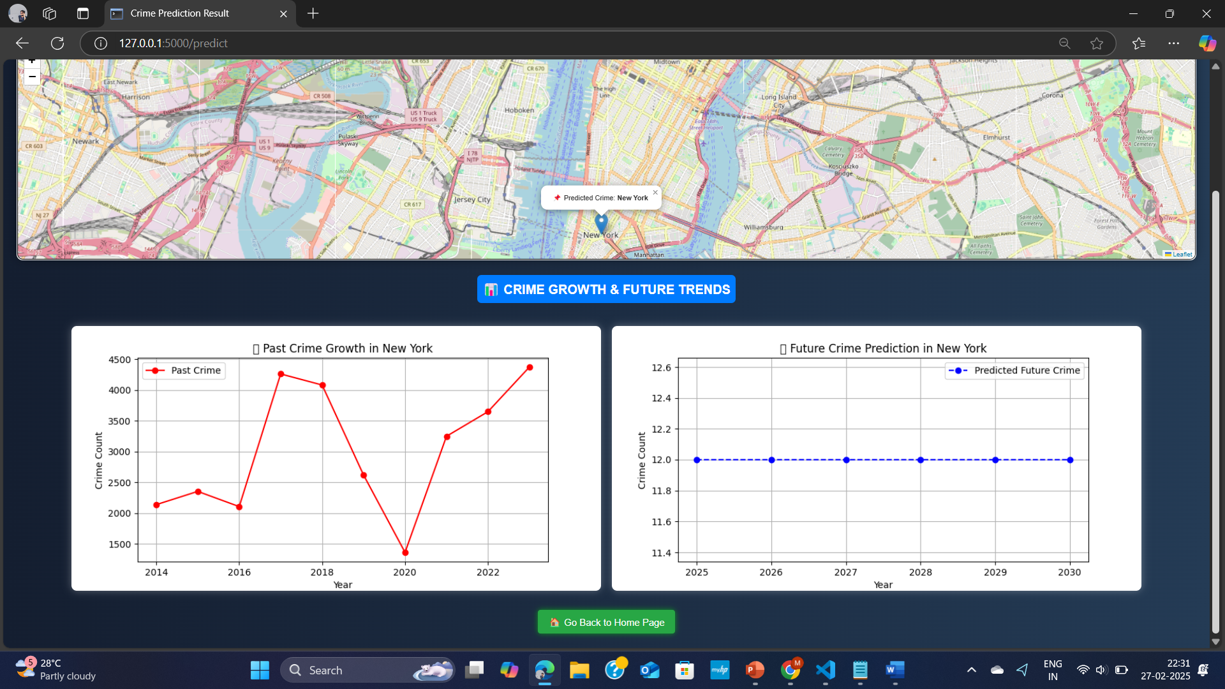

Slide 23
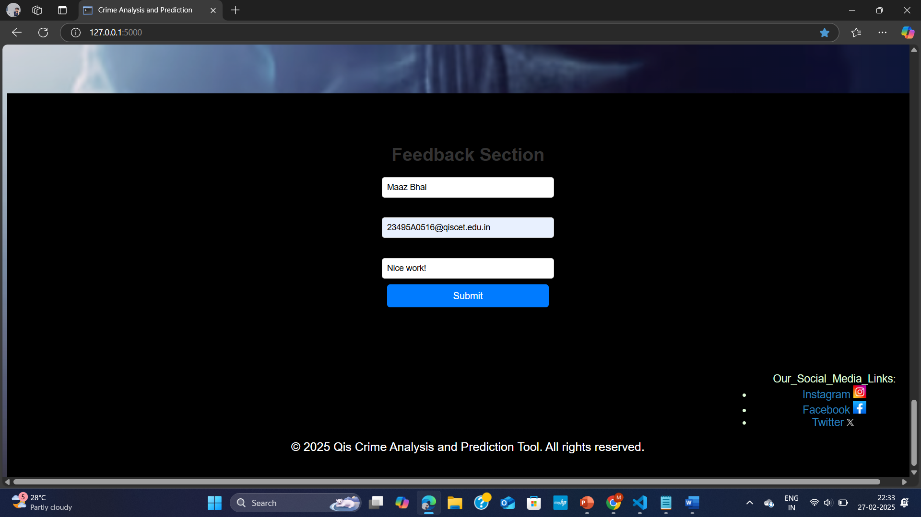

Slide 24


Slide 25
ADVANTAGES
Accurate Crime Analysis
Crime Prediction Capability
Automated Data Handling
User-Friendly Web Interface
Real-Time Data Access
Scalable & Flexible System
Continuous Model Improvement
Reliable Deployment & Monitoring

Slide 26
APPLICATIONs

Slide 27
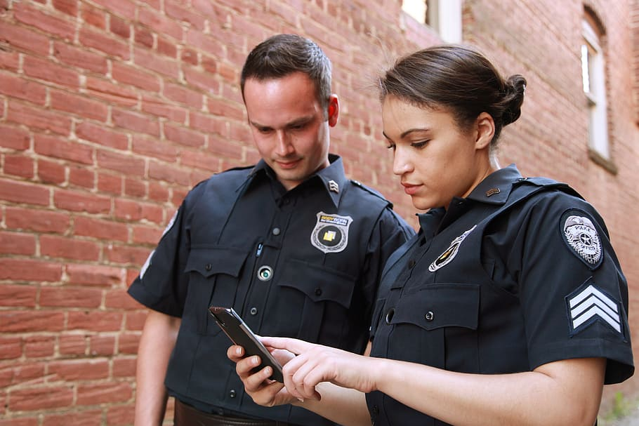
Law Enforcement and Policing

Slide 28

Urban Planning and Development

Slide 29
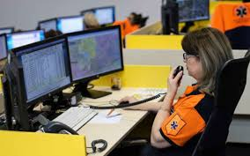
Public Safety and Emergency Response

Slide 30

Real time crime monitoring

Slide 31
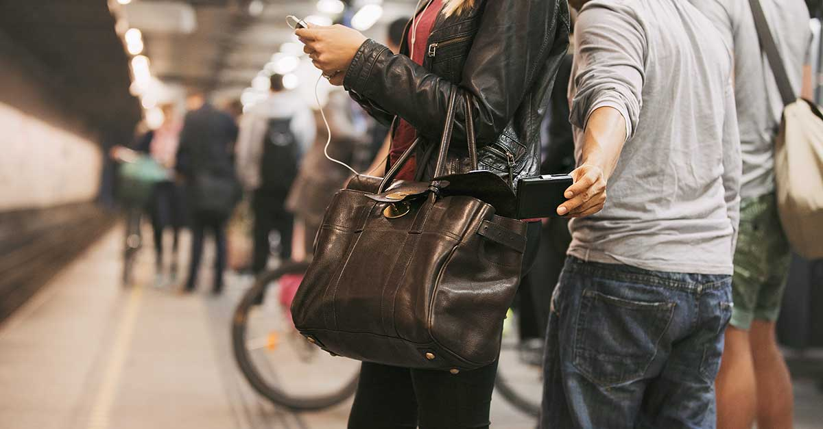
Public transportation

Slide 32
Future scope
Real-time crime tracking
Better prediction accuracy
Crime trend mapping
Support for law enforcement
Mobile app integration
Expansion to more cities
Detecting new crime patterns
Automated alerts for safety

Slide 33
REFERENCE
Smith, J. (2022). Deep learning for crime prediction: A review. Journal of Crime Analytics, 15(3), 45-67..
Jones, A., & Taylor, B. (2023). Predictive policing: Ethical considerations. Law Enforcement Journal, 12(1), 20-35.
Williams, R. (2021). Machine learning applications in crime analysis. *International Conference on Data Science*, 8(2), 101-115.
Neil Shah, Nandish Bhagat, and Manan Shah. Crime forecasting: a machine learning and computer vision approach to crime prediction and prevention. Visual Computing for Industry, Biomedicine, and Art, 4:1–14, 2021.
Albert Meijer and Martijn Wessels. Predictive policing: Review of benefits and drawbacks. International Journal of Public Administration, 42(12):1031–1039, 2019.
Ourania Kounadi, Alina Ristea, Adelson Araujo, and Michael Leitner. A systematic review on spatial crime forecasting. Crime science, 9:1–22, 2020.
Markus Hofmann and Andrew Chisholm. Text mining and visualization: Case studies using open-source tools, volume 40. CRC Press, 2016.
Julia Dressel and Hany Farid. The dangers of risk prediction in the criminal justice system. 2021.
Iqbal H Sarker. Machine learning: Algorithms, realworld applications and research directions. SN computer science, 2(3):160, 2021.
Varvara Ingilevich and Sergey Ivanov. Crime rate prediction in the urban environment using social factors. Procedia Computer Science, 136:472–478, 2018.

Slide 34


Slide 35


